Slide 1

Introduction to Cryptography
This Lecture:
Symmetric Key Cryptography

Slide 2
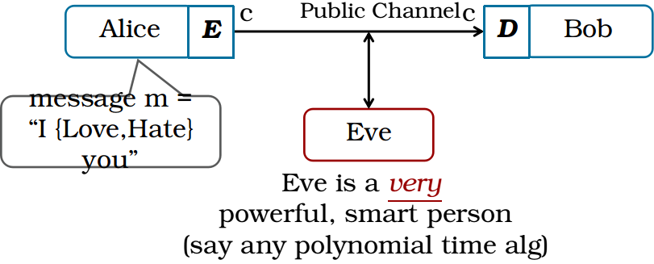
What is Cryptography?
“The study and practice of techniques for secure communication in the presence of adversaries.”

Slide 3
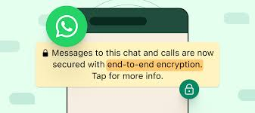

Cryptography is Everywhere...
Secure communication:
web traffic: HTTPS
wireless traffic: 802.11i WPA2 (and WEP), GSM, Bluetooth
Encrypting files on disk: EFS, TrueCrypt
Content protection:
CSS (DVD), AACS (Blue-Ray)
User authentication
Kerberos, HTTP Digest
… and much much more

Slide 4
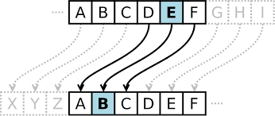
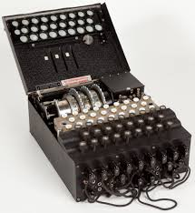
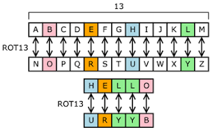
Cryptography before "modern times"
Caesar Cipher: c = m + 3
Substitution cipher
Enigma

Slide 5


Goals of Cryptography
Confidentiality: Only authorized parties can access information.
Integrity: Data remains accurate and unaltered.
Authentication: Verifying the identity of the sender/receiver.
… Modern computing also requires more advanced goals!

Slide 6
Recipe for a Cryptographic Scheme
Defining Algorithms
Formal definition of security
Constructing the algorithms
Proving Security of Construction

Slide 7
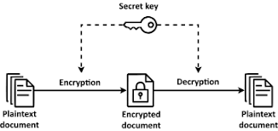

Symmetric Key Encryption
How is the secret key shared between the two parties in the first place?
For now, we will ignore this (or assume that they met in person beforehand)

Slide 8
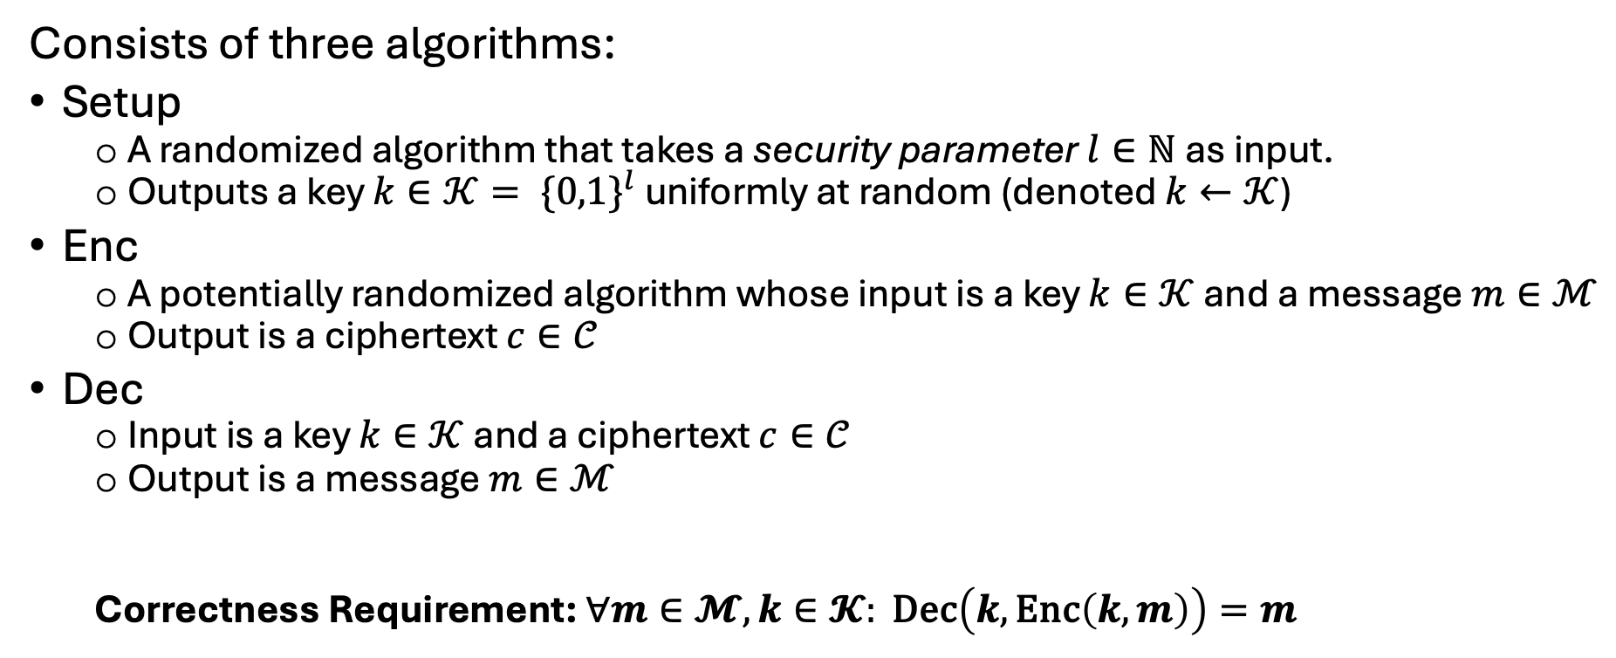
SKE: The algorithms
Consists of three algorithms:
Setup
A randomized algorithm that takes a security parameter $l∈ℕ$ as input.
Outputs a key $k∈𝒦= \{{0,1\}}^{l}$ uniformly at random (denoted $k←𝒦$)
Enc
A potentially randomized algorithm whose input is a key $k∈𝒦$ and a message $m∈ℳ$
Output is a ciphertext $c∈𝒞$
Dec
Input is a key $k∈𝒦$ and a ciphertext $c∈𝒞$
Output is a message $m∈ℳ$
Correctness Requirement: $∀m∈𝓜, k∈𝓚: \text{Dec}\left(k,\text{Enc}\left(k,m\right)\right)=m$

Slide 9
SKE: The Security Requirement
What should be the security requirement?
We wish to ensure confidentiality in the security requirement; i.e. only authorized parties can access information. But what does this mean formally?
Multiple possibilities:
Perfect One Time Security
Computational One Time Security
Computational Many Time Security

Slide 10
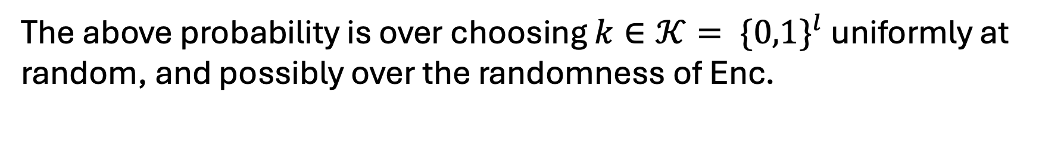
SKE: The Security Requirement
Perfect One Time Security (Shannon 1945)
Informally, we’re no better off determining the plaintext when given the ciphertext.
How can we state this formally?
The above probability is over choosing $k∈𝒦= \{0,1\}^{l}$ uniformly at random, and possibly over the randomness of Enc.

Slide 11

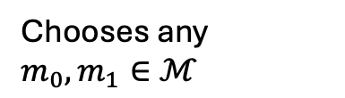


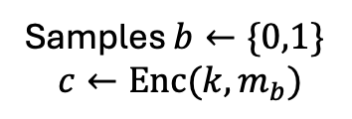
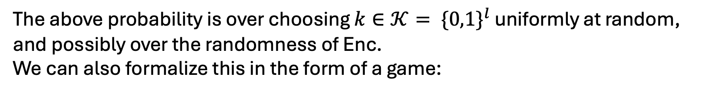

SKE: The Security Requirement
Perfect One Time Security (Shannon 1945)
The above probability is over choosing $k∈𝒦= \{0,1\}^{l}$ uniformly at random, and possibly over the randomness of Enc.
We can also formalize this in the form of a game:
Challenger
Eve
Samples $k←\{{0,1\}}^{l}$
Chooses any $m_{0},m_{1}∈ℳ$
Sends $m_{0},m_{1}$ to challenger
Samples $b←\{0,1\}$
$$c←\text{Enc}(k,m_{b})$$
Sends $c$ to Eve
Sends a guess bit $b′$
Eve wins if $b^{′}=b$. The perfect one time security condition says $\operatorname{Pr}\left[b^{′}=b\right]=\frac{1}{2}$

Slide 12
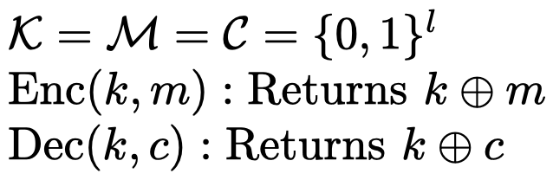

SKE: The Security Requirement
Constructing a scheme which is Perfect One Way Secure:
Shannon’s One Time Pad:
Is this scheme correct?
Easy to verify
How do we show that this is Perfect One way secure?
We need to show that:
Thus, we need to show:
Both the above probabilities are equal to $\frac{1}{2^{l}}$

Slide 13
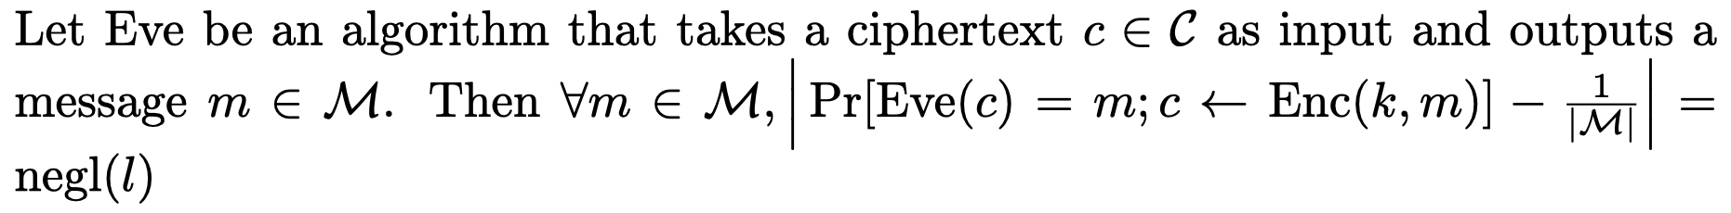
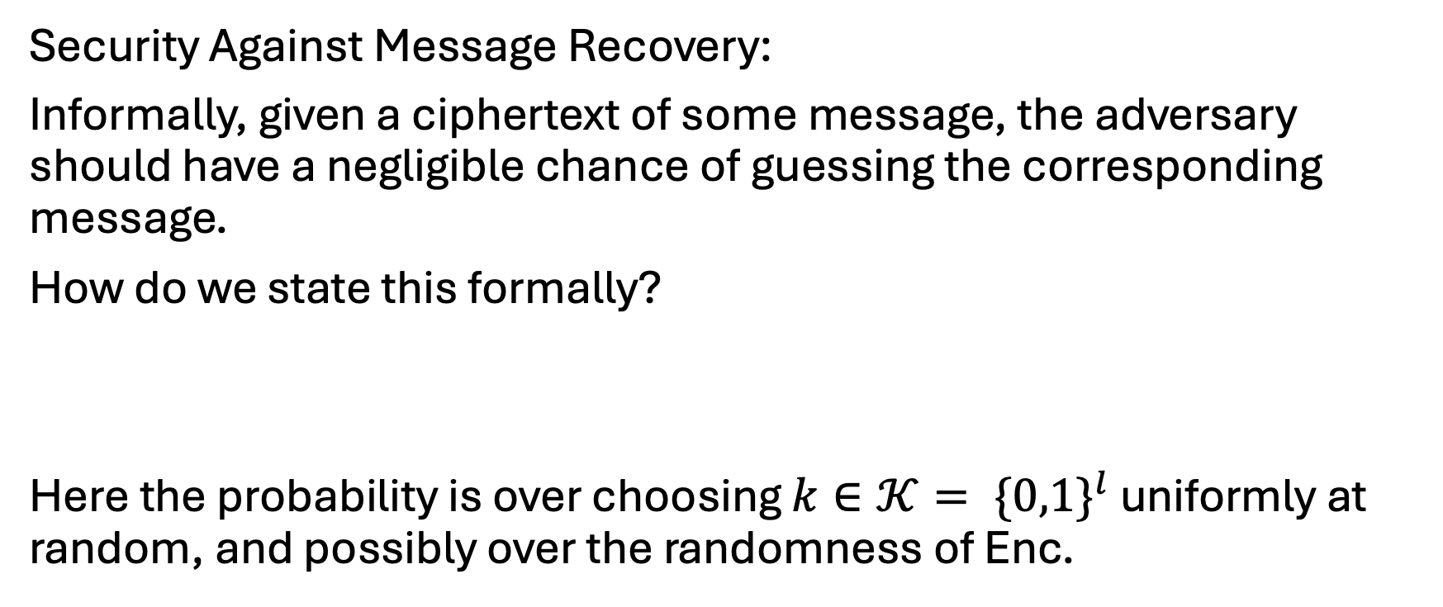
SKE: The Security Requirement
Security Against Message Recovery:
Informally, given a ciphertext of some message, the adversary should have a negligible chance of guessing the corresponding message.
How do we state this formally?
Here the probability is over choosing $k∈𝒦= \{0,1\}^{l}$ uniformly at random, and possibly over the randomness of Enc.

Slide 14
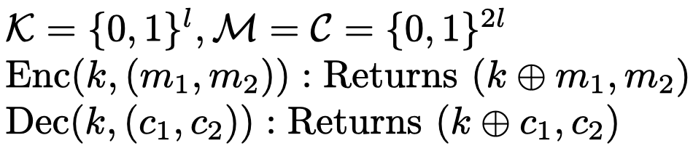
SKE: The Security Requirement
Security against Message Recovery
Is it good enough?
Consider the following scheme:
Does this scheme satisfy correctness?
Yes
Is this scheme secure against message recovery?
Yes
Is there an issue with this scheme?
This does not satisfy perfect one-time security

Slide 15
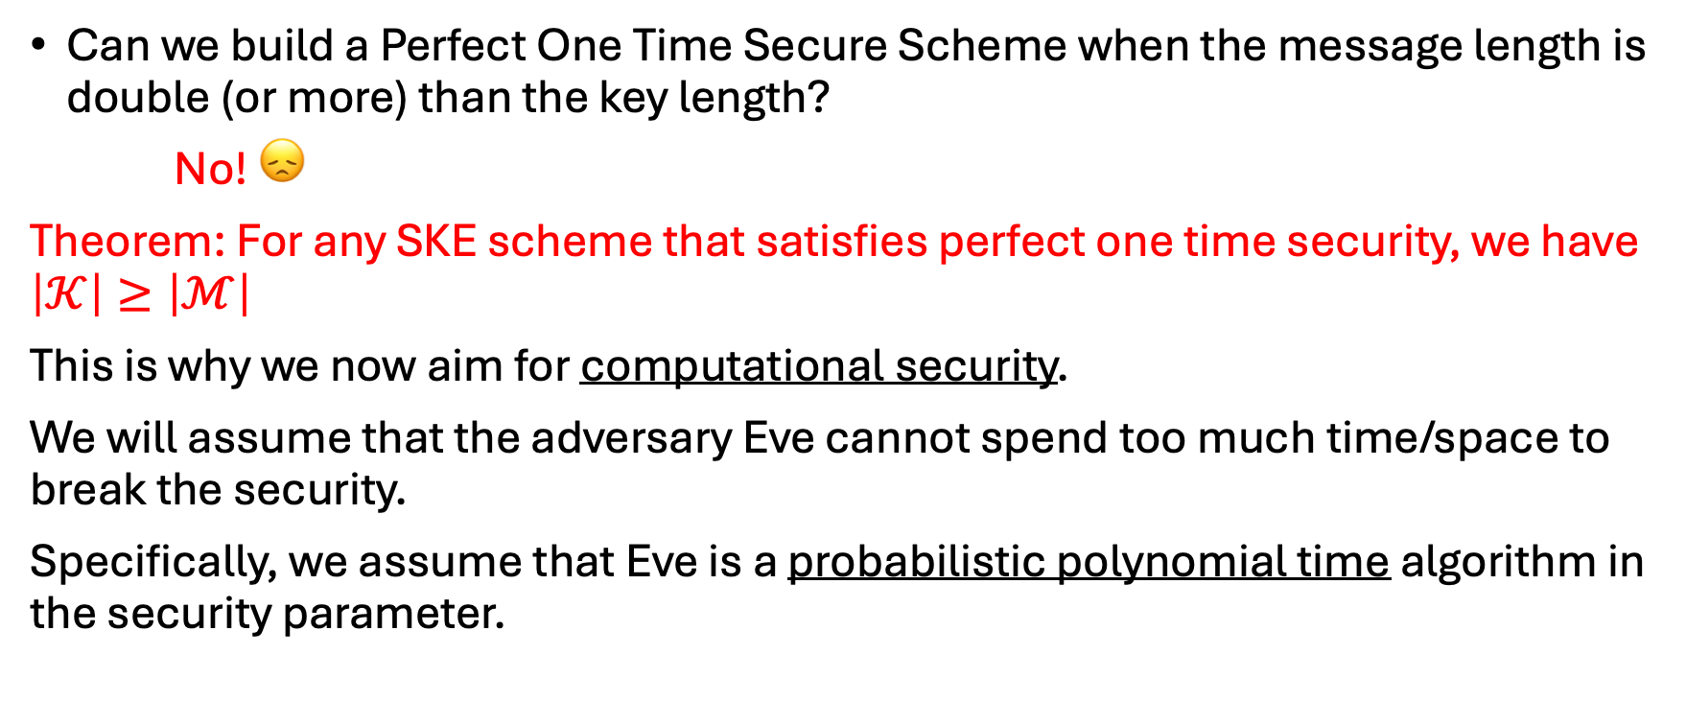
SKE: The Security Requirement
Can we build a Perfect One Time Secure Scheme when the message length is double (or more) than the key length?
No! 😞
Theorem: For any SKE scheme that satisfies perfect one time security, we have $\left|𝒦\right|≥\left|ℳ\right|$
This is why we now aim for computational security.
We will assume that the adversary Eve cannot spend too much time/space to break the security.
Specifically, we assume that Eve is a probabilistic polynomial time algorithm in the security parameter.

Slide 16
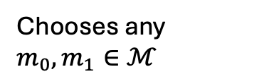
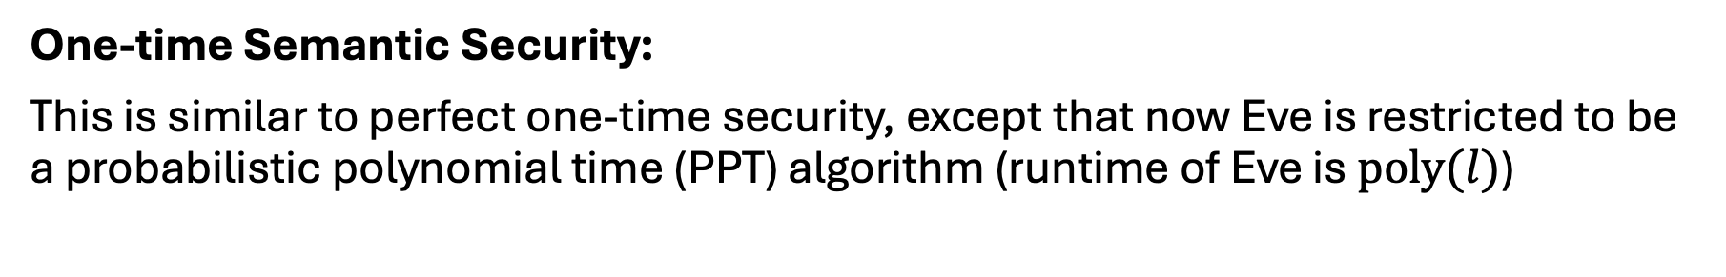

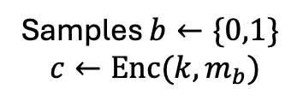

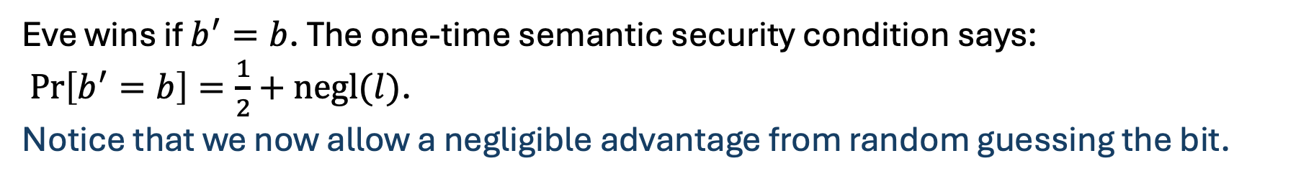
SKE: The Security Requirement
One-time Semantic Security:
This is similar to perfect one-time security, except that now Eve is restricted to be a probabilistic polynomial time (PPT) algorithm (runtime of Eve is $\text{poly}(l)$)
Challenger
Eve
Samples $k←\{{0,1\}}^{l}$
Chooses any $m_{0},m_{1}∈ℳ$
Sends $m_{0},m_{1}$ to challenger
Samples $b←\{0,1\}$
$$c←\text{Enc}(k,m_{b})$$
Sends $c$ to Eve
Sends a guess bit $b′$
Eve wins if $b^{′}=b$. The one-time semantic security condition says:
$\operatorname{Pr}\left[b^{′}=b\right]=\frac{1}{2}+\text{negl}(l)$.
Notice that we now allow a negligible advantage from random guessing the bit.

Slide 17


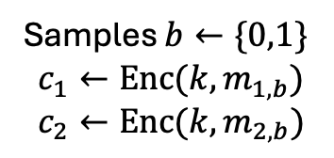
SKE: The Security Requirement
There is one more limitation of Shannon’s one time pad.
It is not “two-time” secure. Recall the security game formulation of one-time security…
Let us modify it so that Eve now has the option to send two sets of messages.
Challenger
Eve
Samples $k←\{{0,1\}}^{l}$
Chooses any $\left(m_{1,0},m_{1,1}\right),\left(m_{2,0},m_{2,1}\right)∈ℳ^{2}$
Sends$(m_{1,0},m_{1,1})$, $\left(m_{2,0},m_{2,1}\right)$to challenger
Samples $b←\{0,1\}$
$$c_{1}←\text{Enc}(k,m_{1,b})$$
$$c_{2}←\text{Enc}(k,m_{2,b})$$
Sends $c_{1},c_{2}$ to Eve
Sends a guess bit $b′$
Ex: Can you devise a strategy for Eve to win this game for the Shannon’s scheme?

Slide 18


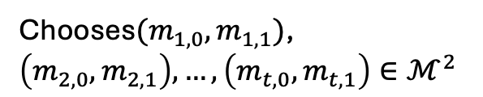

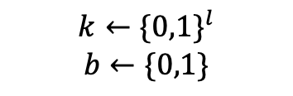

SKE: The Security Requirement
We now want to design a security game for SKE against PPT adversaries who can send multiple queries (pairs of messages) to the challenger. Consider two candidate games:
Game 1:
Challenger
Eve
$$k←\{{0,1\}}^{l}$$
$$b←\{0,1\}$$
Chooses$(m_{1,0},m_{1,1})$, $\left(m_{2,0},m_{2,1}\right), …,\left(m_{t,0},m_{t,1}\right)∈ℳ^{2}$
$(m_{1,0},m_{1,1})$, $\left(m_{2,0},m_{2,1}\right), …,\left(m_{t,0},m_{t,1}\right)$
$$c_{1}←\text{Enc}(k,m_{1,b})$$
$$c_{2}←\text{Enc}\left(k,m_{2,b}\right)$$
$$⋮$$
$$c_{t}←\text{Enc}\left(k,m_{t,b}\right)$$
$c_{1},c_{2},…,c_{t}$
$$b′$$

Slide 19





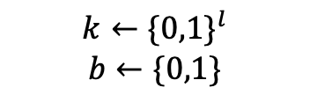



SKE: The Security Requirement
Game 2:
Challenger
Eve
$$k←\{{0,1\}}^{l}$$
$$b←\{0,1\}$$
Chooses$(m_{1,0},m_{1,1})∈ℳ^{2}$
$$(m_{1,0},m_{1,1})$$
$$c_{1}←\text{Enc}(k,m_{1,b})$$
$$c_{1}$$
$$⋮$$
Chooses$(m_{t,0},m_{t,1})∈ℳ^{2}$
$$(m_{1,0},m_{1,1})$$
$$c_{t}←\text{Enc}(k,m_{t,b})$$
$$c_{t}$$
$$b′$$

Slide 20
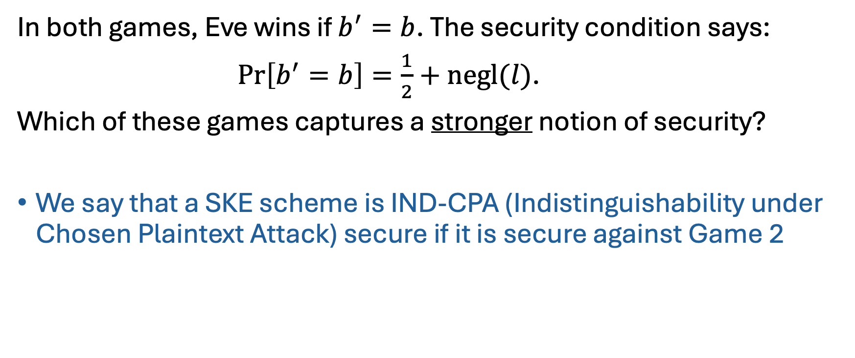
SKE: The Security Requirement
In both games, Eve wins if $b^{′}=b$. The security condition says:
$\operatorname{Pr}\left[b^{′}=b\right]=\frac{1}{2}+\text{negl}(l)$.
Which of these games captures a stronger notion of security?
We say that a SKE scheme is IND-CPA (Indistinguishability under Chosen Plaintext Attack) secure if it is secure against Game 2

Slide 21
SKE: Constructing IND-CPA
How do we construct such a scheme?
How do we exploit the computational limitation (PPT algorithm) of the adversary?
If we knew a problem that is provably unsolvable by a PPT algorithm, we could hope to somehow use that to build our scheme.
In order to break the scheme, Eve would have to solve this problem, which it couldn’t, cause it’s PPT.

Slide 22
SKE: Constructing IND-CPA
Are there problems which are hard for PPT algorithms?
Believably, but not provably! This constitutes one of the most important in theoretical computer science.
So we will assume there exists some task which is hard for any PPT algorithm, and we will then use it to construct IND-CPA SKE.
The scheme will be secure assuming the task is hard

Slide 23
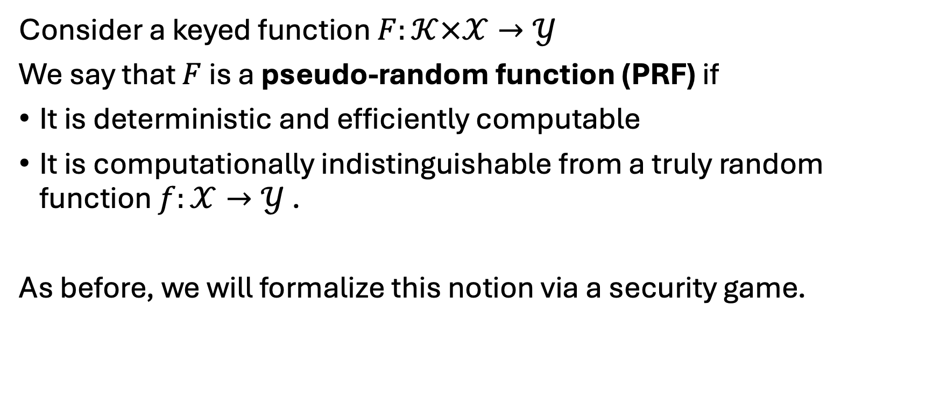
Pseudo Random Functions
Consider a keyed function $F:𝒦×𝒳→𝒴$
We say that $F$ is a pseudo-random function (PRF) if
It is deterministic and efficiently computable
It is computationally indistinguishable from a truly random function $f:𝒳→𝒴$ .
As before, we will formalize this notion via a security game.

Slide 24





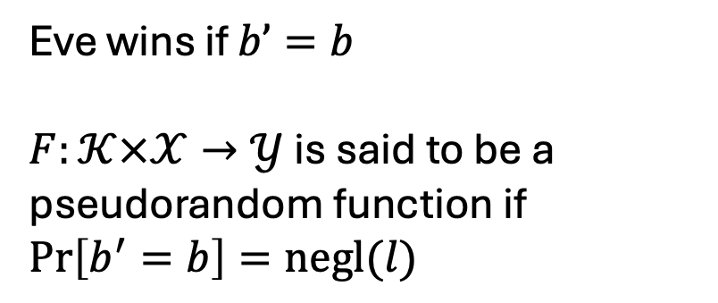
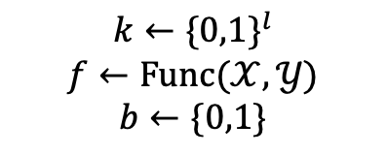

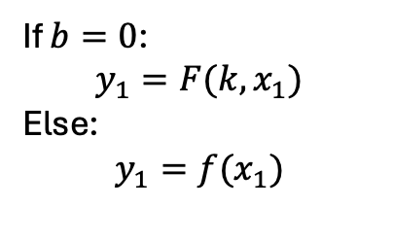

Pseudo Random Functions
Challenger
Eve
$$k←\{{0,1\}}^{l}$$
$$f←\text{Func}(𝒳,𝒴)$$
$$b←\{0,1\}$$
Chooses$x_{1}∈𝒳$
$$x_{1}$$
If $b=0$:
$$y_{1}=F(k,x_{1})$$
Else:
$$y_{1}=f(x_{1})$$
$$y_{1}$$
Eve wins if $b’=b$
$F:𝒦×𝒳→𝒴$ is said to be a pseudorandom function if $\operatorname{Pr}\left[b^{′}=b\right]=\text{negl}(l)$
$$⋮$$
$$x_{t}$$
$$y_{t}$$
$$b^{′}$$

Slide 25
Psuedo Random Functions
Are there any known pseudo random functions?
Again, not provably!
Assuming existence of another ‘simpler’ primitive called a One Way Function (OWF), we can construct a PRF.
In practice, there are few candidates which are treated as PRFs
Eg. AES, SHA-256, ChaCha20
These are assumed to behave like PRFs based on empirical analysis and the absence of known attacks.

Slide 26
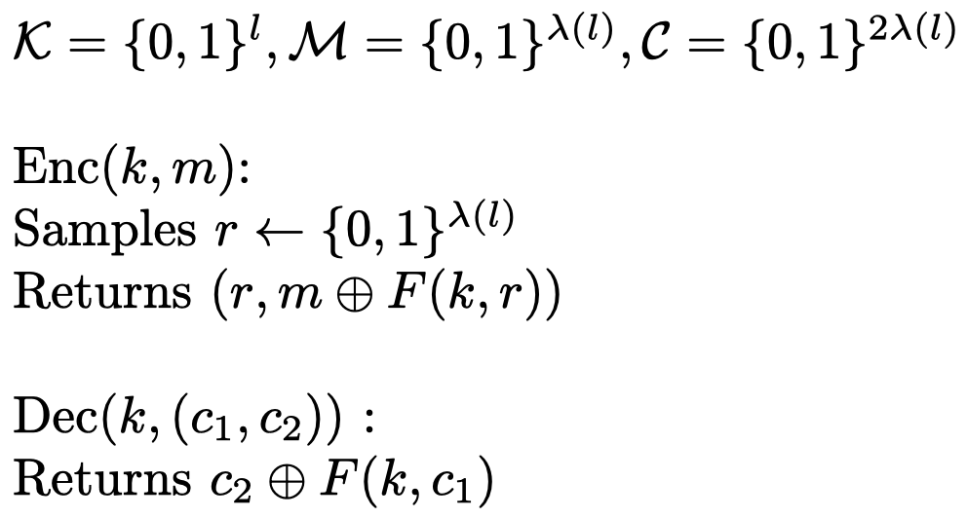

Constructing IND-CPA Scheme
Given a PRF $F:\{0,1\}^{l}×\{0,1\}^{λ(l)}→\{0,1\}^{λ(l)}$ (for some $λ$), here is a construction of a SKE scheme:

Slide 27
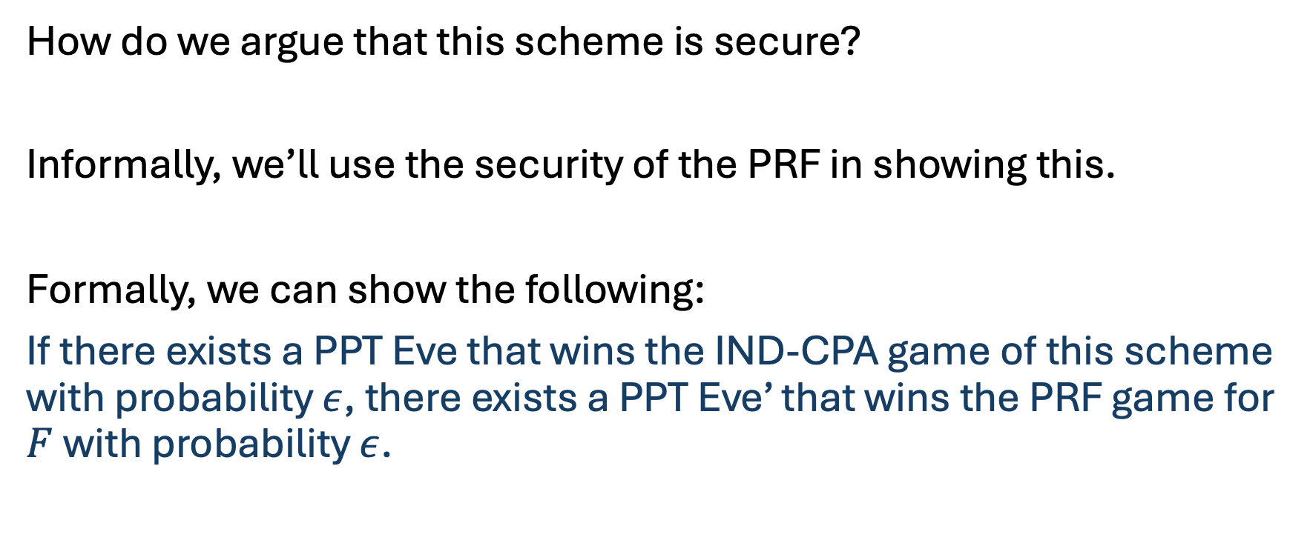
Arguing the scheme is IND-CPA secure
How do we argue that this scheme is secure?
Informally, we’ll use the security of the PRF in showing this.
Formally, we can show the following:
If there exists a PPT Eve that wins the IND-CPA game of this scheme with probability $ε$, there exists a PPT Eve’ that wins the PRF game for $F$ with probability $ε$.

Slide 28

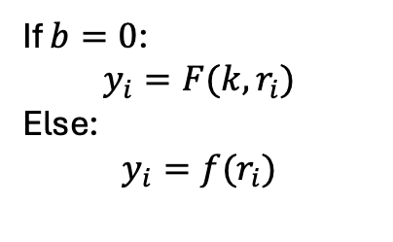








Arguing the scheme is IND-CPA secure
Challenger (for PRF)
Eve’
Eve (for CPA)
$$k←\{{0,1\}}^{l}$$
$$f←\text{Func}(𝒳,𝒴)$$
$$b←\{0,1\}$$
$$b^{′}←\{0,1\}$$
$$m_{i,0},m_{i,1}$$
$$r_{i}←\{0,1\}^{λ\left(l\right)}$$
If $b=0$:
$$y_{i}=F(k,r_{i})$$
Else:
$$y_{i}=f(r_{i})$$
$$r_{i}$$
For $i=1 \text{to} t$
$$y_{i}$$
$$(r_{i},m_{i,b^{′}}⊕y_{i})$$
$$b′′$$
If $b^{′}=b^{′′}$:
0 (pseudorandom)
Else:
1 (truly random)

Slide 29
Message Authentication Codes
So far, we built a scheme that ensured confidentiality.
How can we design a scheme that ensures authenticity, i.e. verifying that a message comes from an authentic sender, and has not been forged?
Cryptographic Primitive to ensure this:
Message Authentication Code (MAC)

Slide 30
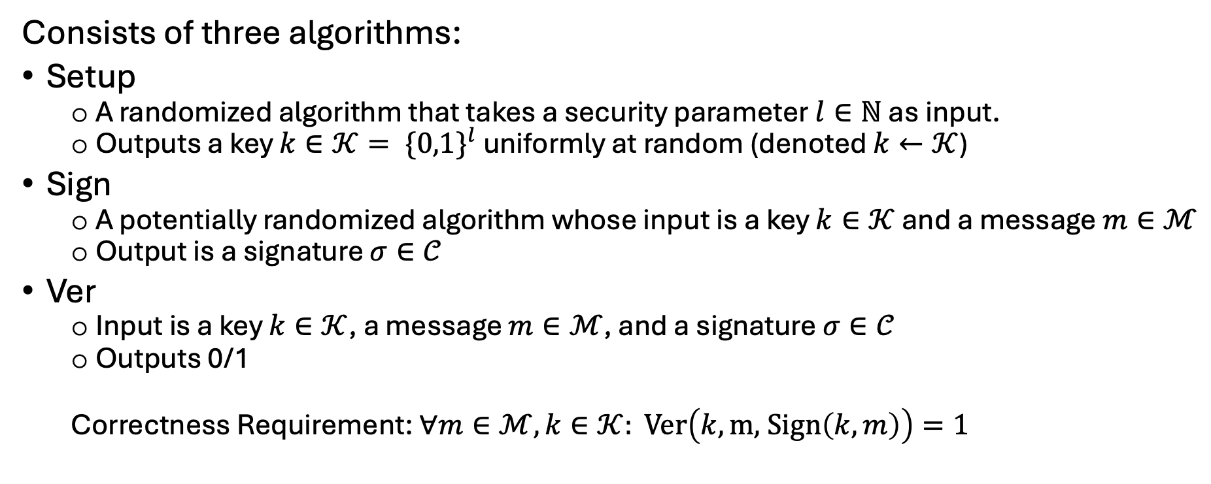
Message Authentication Codes
Consists of three algorithms:
Setup
A randomized algorithm that takes a security parameter $l∈ℕ$ as input.
Outputs a key $k∈𝒦= \{{0,1\}}^{l}$ uniformly at random (denoted $k←𝒦$)
Sign
A potentially randomized algorithm whose input is a key $k∈𝒦$ and a message $m∈ℳ$
Output is a signature $σ∈𝒞$
Ver
Input is a key $k∈𝒦$, a message $m∈ℳ$, and a signature $σ∈𝒞$
Outputs 0/1
Correctness Requirement: $∀m∈ℳ, k∈𝒦: \text{Ver}\left(k,\text{m}\text{, }\text{Sign}\left(k,m\right)\right)=1$

Slide 31






Message Authentication Codes
As usual, we need a security game that captures the following intuition: An adversary Eve should not be able to produce a forged signature, even if it has seen several valid signatures.
Challenger
Eve
Samples $k←\{{0,1\}}^{l}$
$$m_{i}$$
$$σ_{i}←\text{Sign}(k,m_{i})$$
For $i=1 \text{to} t$
$$σ_{i}$$
$$(m^{∗},σ^{∗})$$
Eve wins if $∀i∈\left[t\right], \left(m^{∗},σ^{∗}\right)≠(m_{i},σ_{i})$ and $\text{Ver}\left(k,m^{∗},σ^{∗}\right)=1$

Slide 32


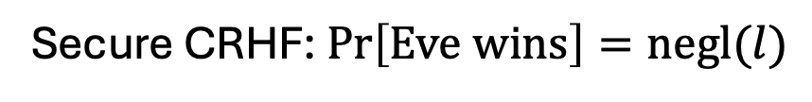
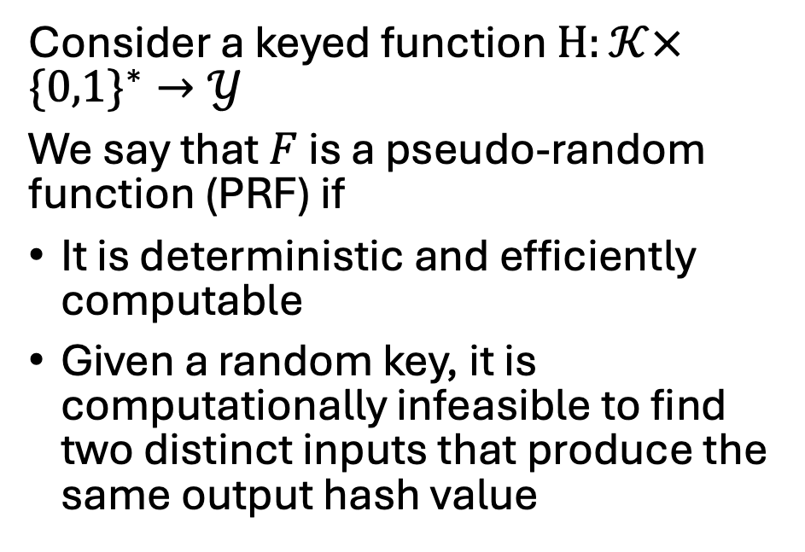
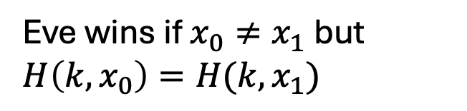


Collision Resistant Hash Functions
Challenger
Eve
Consider a keyed function $H:𝒦×\{0,1\}^{∗}→𝒴$
We say that $F$ is a pseudo-random function (PRF) if
It is deterministic and efficiently computable
Given a random key, it is computationally infeasible to find two distinct inputs that produce the same output hash value
$$k←\{{0,1\}}^{l}$$
$$k$$
$$(x_{0},x_{1})$$
Eve wins if $x_{0}≠x_{1}$ but $H\left(k,x_{0}\right)=H(k,x_{1})$
Secure CRHF: $\operatorname{Pr}\left[\text{Eve} \text{wins}\right]=\text{negl}(l)$
Food for thought: Try to to construct a MAC for unbounded length messages using a CRHF and a PRF together!

Slide 33




Ciphertext Integrity
How can we design a SKE scheme that ensures integrity, i.e. an adversary cannot alter the ciphertext without being detected?
Challenger
Eve
Samples $k←\{{0,1\}}^{l}$
$$m_{i}$$
$$c_{i}←\text{Enc}(k,m_{i})$$
For $i=1 \text{to} t$
$$c_{i}$$
$$c^{∗}$$
Eve wins if $∀i∈\left[t\right], c^{∗}≠c_{i}$ and $Dec\left(k,c^{∗}\right)≠⊥$
Food for thought: Try to to construct a SKE for ciphertext integrity using an IND-CPA SKE and MAC together!

Slide 34

Coming Up: Public Key Cryptography
Thank You!

