Slide 1

Public Key Cryptography
Anish Banerjee
Btech CSE, IIT Delhi

Slide 2
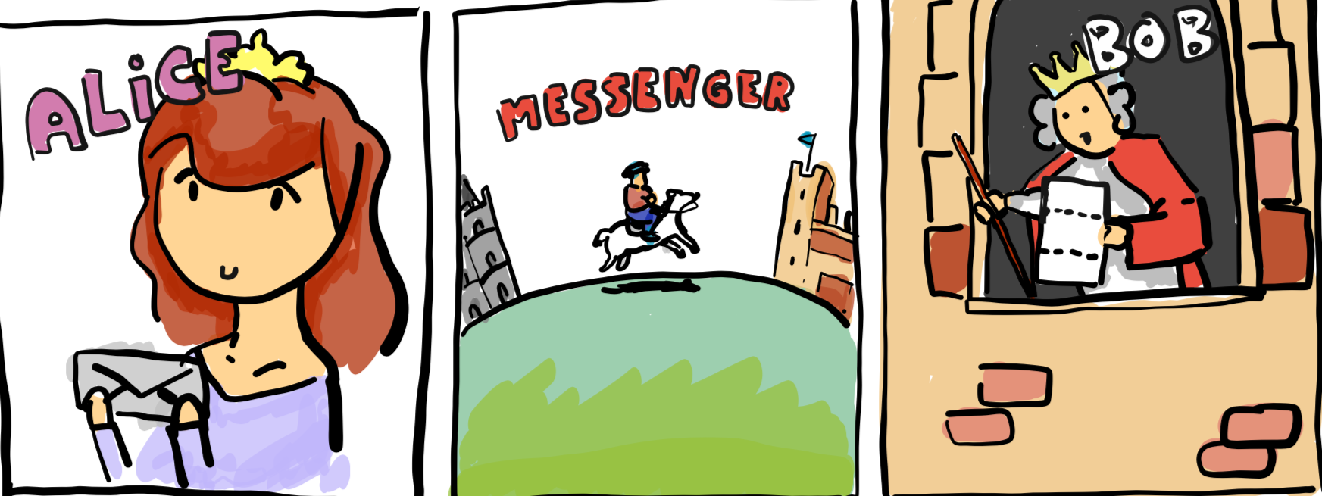
Contents
Source: Real World Cryptography
Why Public Key Encryption?
Definitions: Syntax, Security
Constructions
Quiz!
Advanced Primitives
Notes:
This comic strip demonstrates how easy things were before the advent of the internet. The only cryptography used was 'folding the paper really tight'

Slide 3
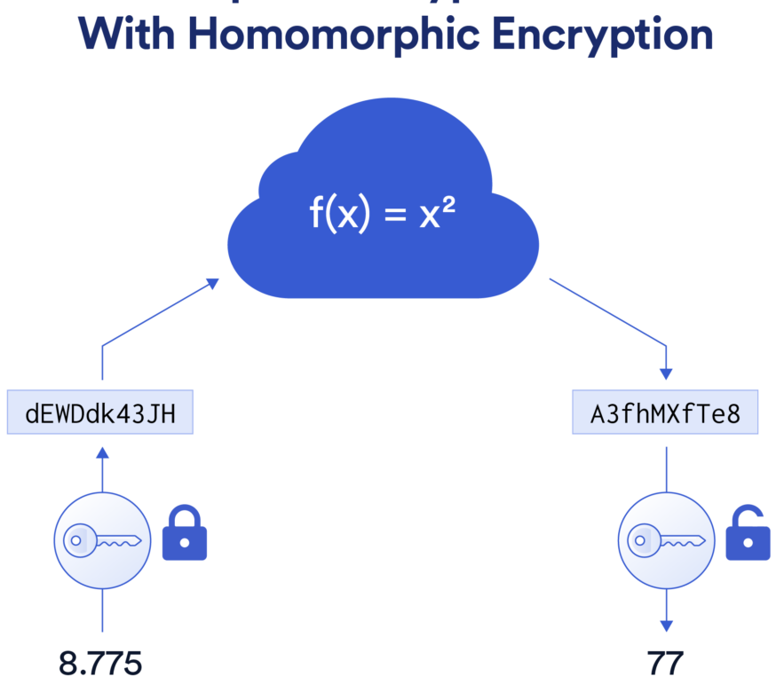
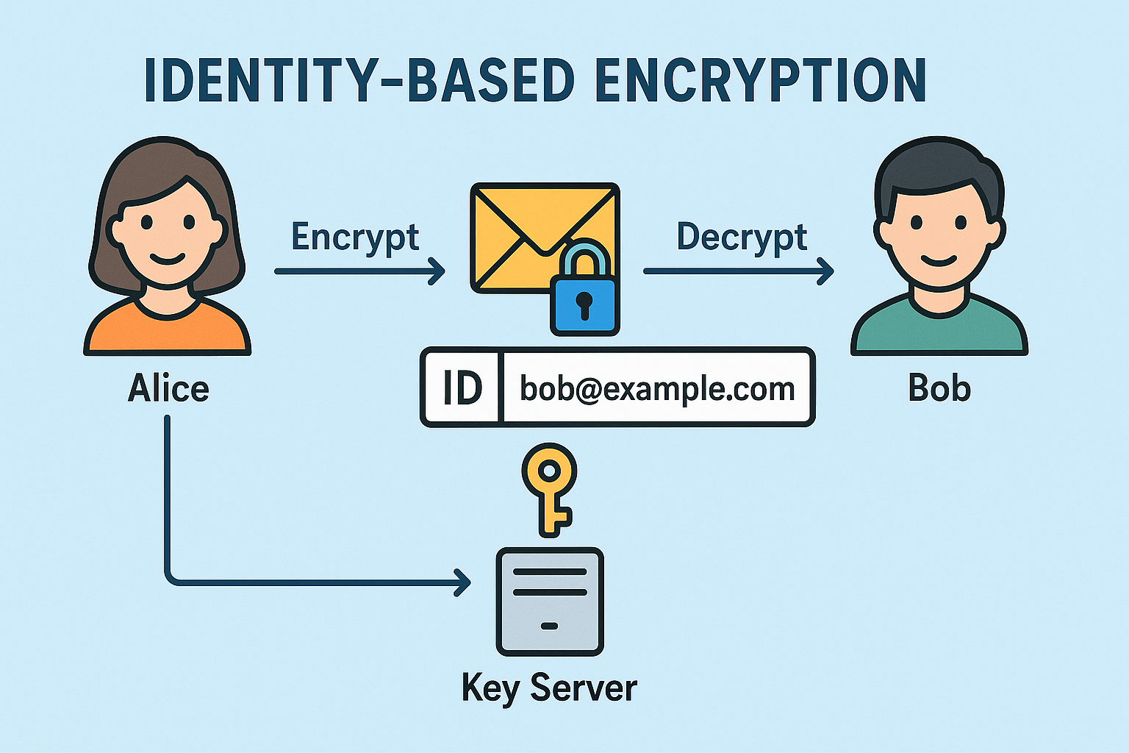
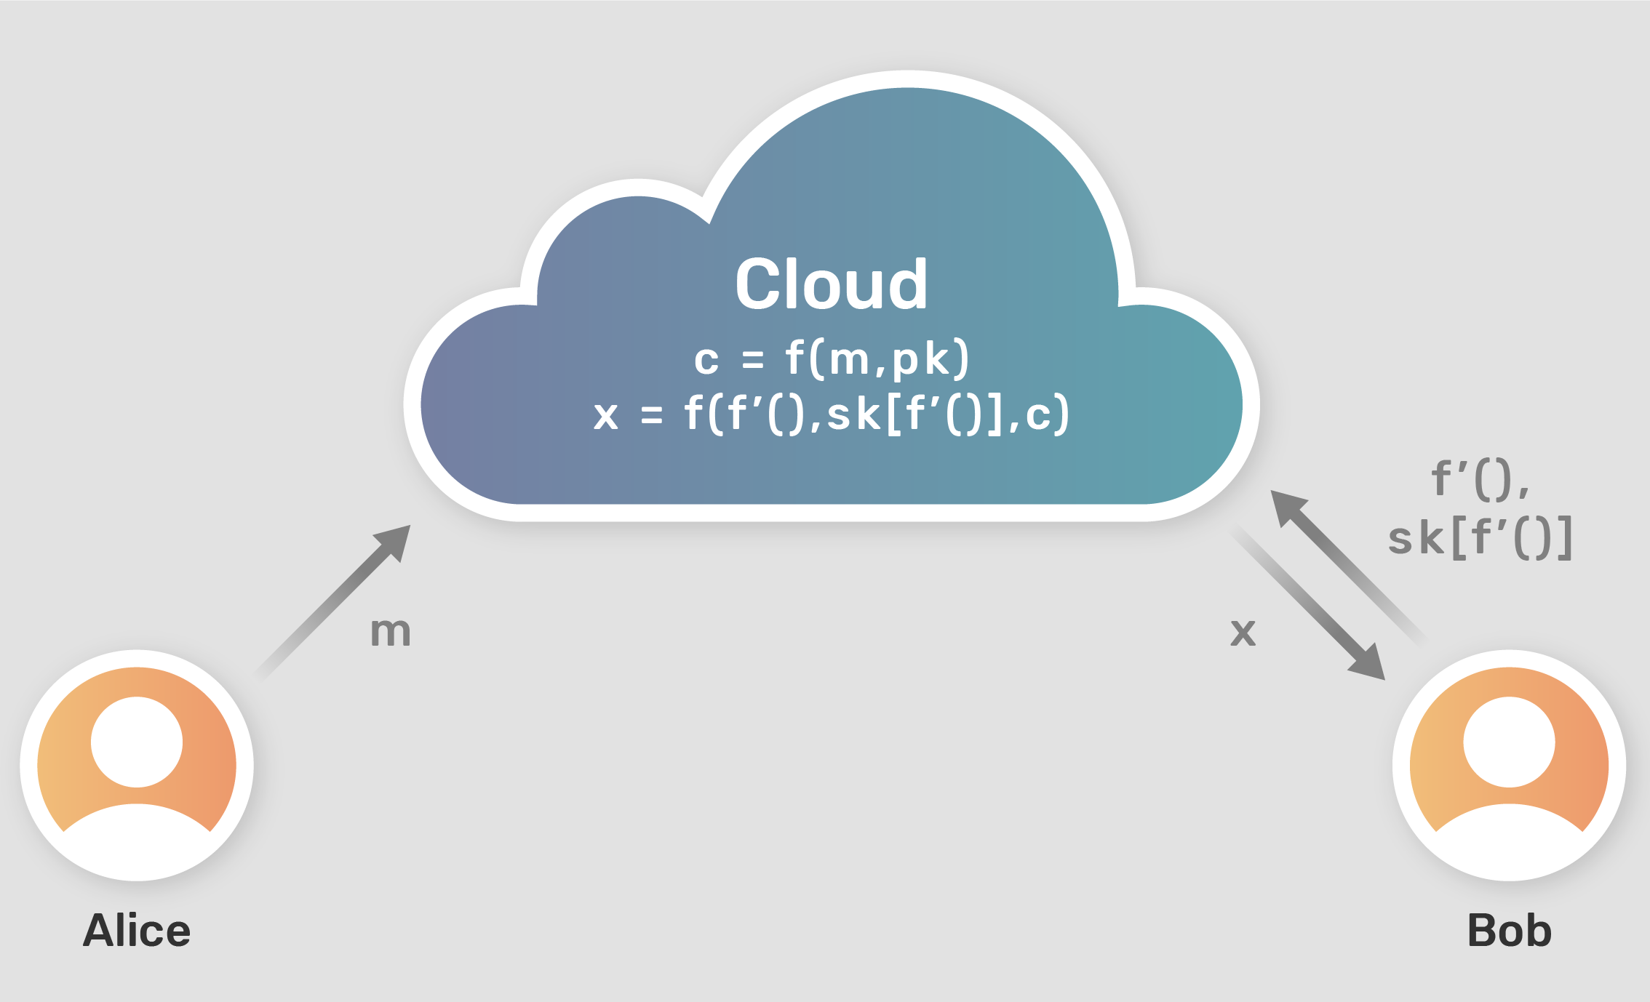
Why Public Key Encryption?
HOMOMORPHIC ENCRYPTION
How to agree on a key?
Foundations for advanced crypto
It’s fun!
FUNCTIONAL ENCRYPTION
Source: https://chain.link/education-hub/homomorphic-encryption
Source: https://openmined.org/blog/privacy-teaching-series-what-is-functional-encryption/

Slide 4





Syntax
(Setup, Enc, Dec)
Want: Send message m
No shared key ☹
(pk, sk) $←$Setup()
pk
ct
ct $←$ Enc(pk, m)
m’ $←$ Dec(sk, ct)
Correctness: m=m’
Notes:
Assume that channel is authenticated

Slide 5
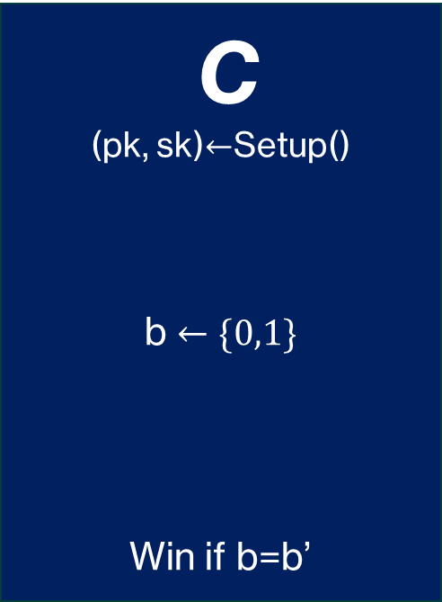
Security (Chosen Plaintext Attacks)
C
(pk, sk)$←$Setup()
b $←\{0,1\}$
Win if b=b’
A
pk
Enc, m
ct=Enc(pk, m)
m₀, m₁
Enc(pk, m_{b})
b’
Secure if Pr[Win] is ½+negligible
Notes:
Reduces to semantic security in the public key setting

Slide 6
Security (Chosen Ciphertext Attacks)
C
pk
A
Enc, m
ct
Dec, ct
m
m₀, m₁
Enc(pk, m_{b})
Dec*, ct
m
b’

Slide 7
Constructing PKE
Cannot build from PRFs ☹
Need more “structured” crypto assumptions
Can be broken by a quantum computer!
Structured Assumptions
Diffie Helman
Discrete Logarithm
RSA
Factoring N=pq
Learning With Errors
Lattice Problems

Slide 8
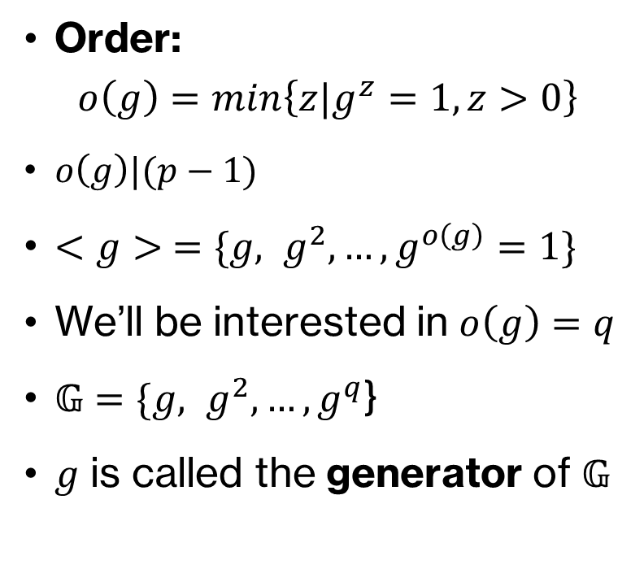
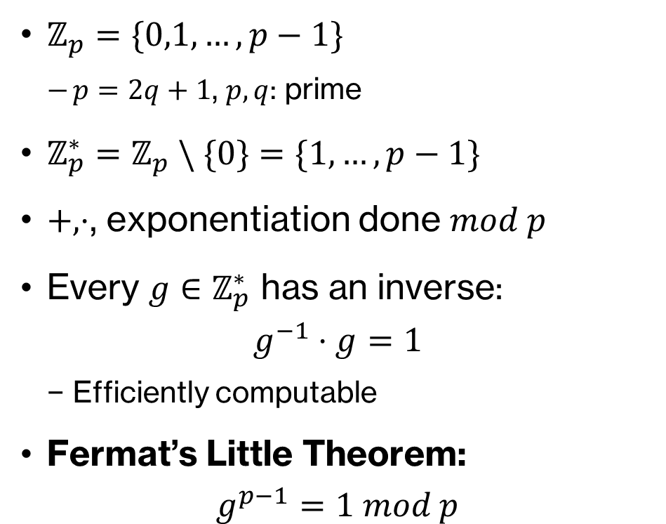
Modular Arithmetic
$ℤ_{p}=\{0,1,…, p−1\}$
$p=2q+1$, $p,q$: prime
$ℤ_{p}^{∗}=ℤ_{p} \backslash \{0\}=\{1,…, p−1\}$
$+, ⋅$, exponentiation done $mod p$
Every $g∈ℤ_{p}^{∗}$ has an inverse: $g^{−1}⋅g=1$
Efficiently computable
Fermat’s Little Theorem: $g^{p−1}=1 mod p$
Order: $o\left(g\right)=\min\left\{{z|g}^{z}=1, z>0\right\}$
$o\left(g\right)|(p−1)$
$<g> =\{g, g^{2}, …, g^{o\left(g\right)}=1\}$
We’ll be interested in $o\left(g\right)=q$
$𝔾$ $=\{g, g^{2}, …, g^{q}$}
$g$ is called the generator of $𝔾$

Slide 9
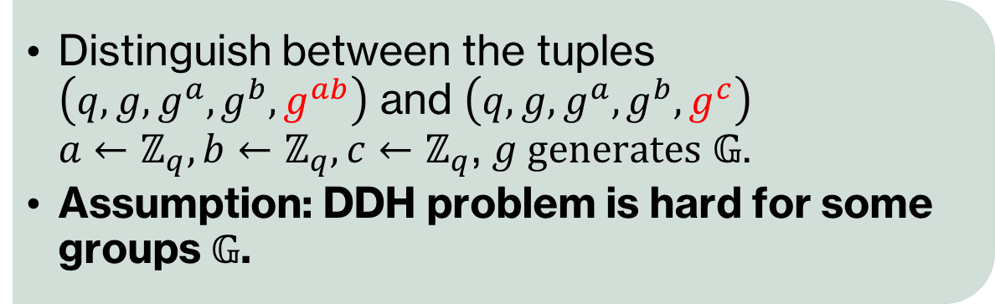
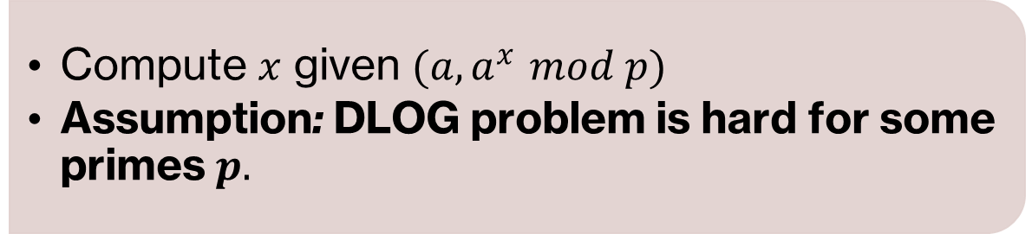
Diffie Helman
Discrete Logarithm (DLOG)
Compute $x$ given $(a, a^{x} mod p)$
Assumption: DLOG problem is hard for some primes $p.$
Decisional Diffie Helman (DDH)
Distinguish between the tuples $\left(q,g,g^{a},g^{b}, g^{ab}\right)$ and $\left(q,g,g^{a},g^{b}, g^{c}\right)$ $a←ℤ_{q},b←ℤ_{q},c←ℤ_{q}$, $g generates 𝔾$.
Assumption: DDH problem is hard for some groups $𝔾$.

Slide 10

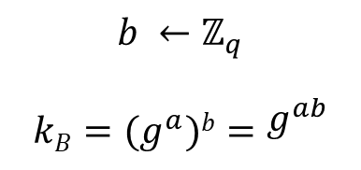
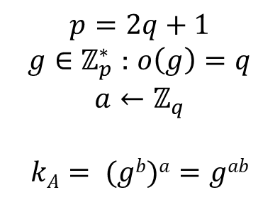
Key Agreement
Want:
Agree on a key
$$p=2q+1$$
$g∈ℤ_{p}^{∗}$ : $o\left(g\right)=q$
$$a←ℤ_{q}$$
$$kA= (gb)a=gab$$
$$(q, g, g^{a})$$
$$gb$$
$$b ←ℤ_{q}$$
$$kB=(g^{a})b=g^{ab}$$
Correctness: $k_{A}=k_{B}$ Security: Can’t learn $g^{ab}$ given $(q,g,g^{a}, g^{b})$

Slide 11




Public Key Encryption
Quiz!
Want: Send message m
No shared key ☹
(pk, sk) $←$Setup()
pk
ct
ct $←$ Enc(pk, m)
m’ $←$ Dec(sk, ct)
DDH Assumption: $\left(q,g,g^{a},g^{b}, g^{ab}\right)≈\left(q,g,g^{a},g^{b}, g^{c}\right)$
[Assume: m$∈𝔾$, $q≫$m]

Slide 12
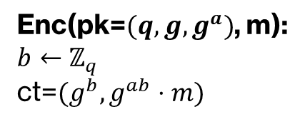
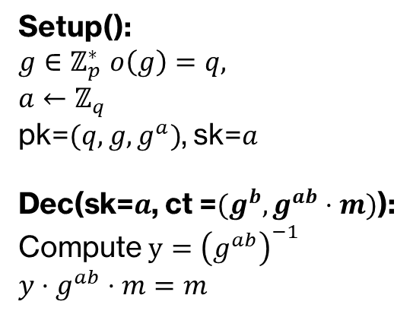
Public Key Encryption
Setup():
$g∈ℤ_{p}^{∗}$ $o\left(g\right)=q,$
$a←ℤ_{q}$
pk=$(q,g,g^{a})$, sk=$a$
Dec(sk=$a$, ct =$(g^{b}, g^{ab}⋅m)$):
Compute $y={\left(g^{ab}\right)}^{−1}$
$y⋅g^{ab}⋅m=m$
pk
Enc(pk=$(q,g,g^{a})$, m):
$b←ℤ_{q}$
ct=$(g^{b}, g^{ab}⋅m)$
ct
Security: $\left(q,g,g^{a},g^{b}, g^{ab}⋅m\right)≈\left(q,g,g^{a},g^{b}, g^{c}⋅m\right)$

Slide 13


Exercise
$\text{ct}\text{1}\text{=}\left(g^{b_{1}}, g^{ab_{1}}⋅m_{1}\right)$
$\text{ct}\text{2}\text{=}\left(g^{b_{2}}, g^{ab_{2}}⋅m_{2}\right)$
Ciphertext for m₁m₂?
$\text{ct}\text{3}\text{=}\left({g^{b_{1}}⋅g}^{b_{2}}, {g^{ab_{1}}⋅m_{1}⋅g}^{ab_{2}}⋅m_{2}\right)$ $=\left(g^{b_{1}+b_{2}}, g^{a(b_{1}+b_{2})}m_{1}{⋅m}_{2}\right)$
Multiplicative Homomorphism
Computing on Encrypted Data!

Slide 14

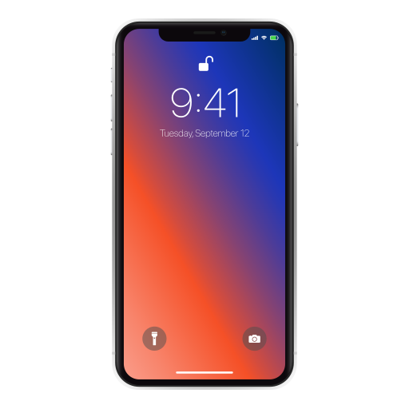
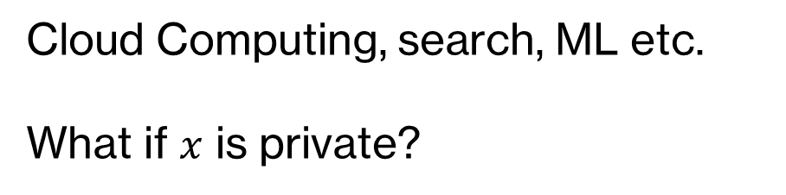




Outsourcing Computation
$$x$$
$$x$$
$$f$$
$$f(x)$$
Cloud Computing, search, ML etc.
What if $x$ is private?

Slide 15


Outsourcing Computation - Privately
Enc(x)
$$x$$
y
$$f$$
Dec(y)=f(x)
Want:
Homomorphic Evaluation Function
Eval(f, Enc(x))=Enc(f(x))

Slide 16
Fully Homomorphic Encryption
pk, sk
pk
Enc(pk, x)
x
f
y=Eval(f, Enc(pk, x))
Correctness: Dec(sk, y)=f(x)
Security: CPA security
Compactness: |y| is independent of f
Can be constructed using Lattices.
Notes:
In most cases the data owner is not the data sender
Easy to achieve if Eval outputs input and f. Decryption decrypts the ciphertext and evaluates the function.

Slide 17
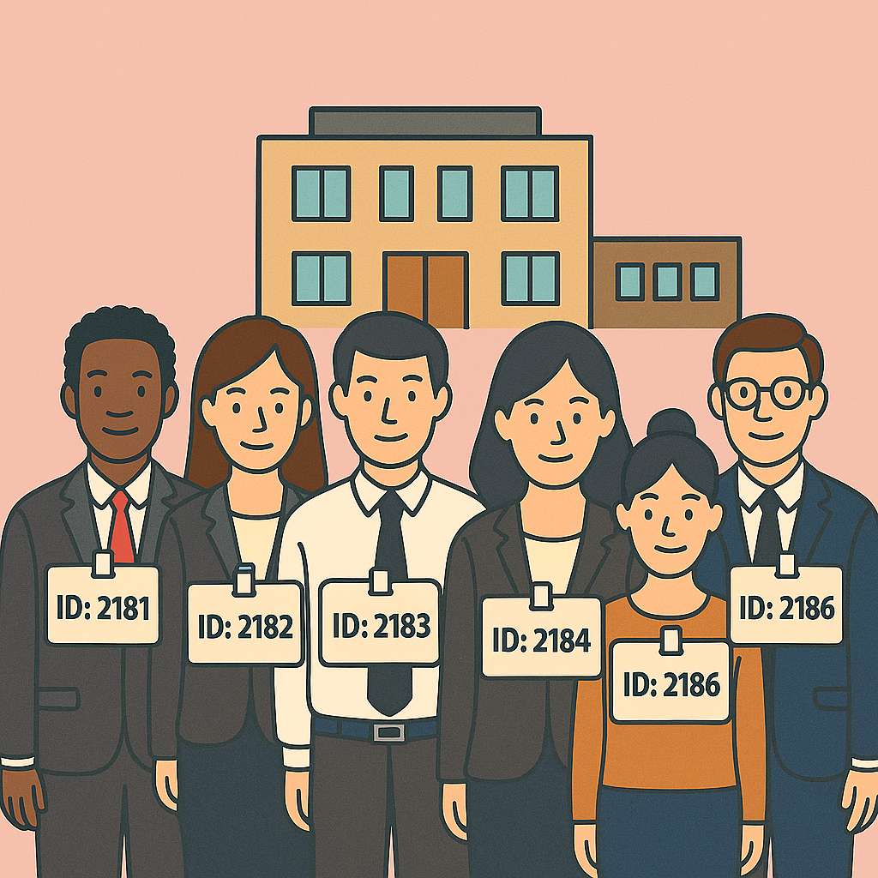
Identity Based Encryption
PKE: Need to store a database of pk ☹
Make your ID your pk!
Everyone has a secret key corresponding to their ID.

Slide 18



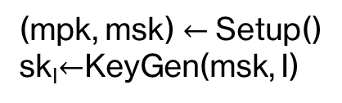
Identity Based Encryption
(Setup, KeyGen, Enc, Dec)
Broadcast
(mpk, msk) $←$Setup()
sk_{I}$←$KeyGen(msk, I)
Want: Send message m
No shared key ☹
sk_{I}

Slide 19


Identity Based Encryption
(Setup, KeyGen, Enc, Dec)
Alice’s Public ID I
Eg: I=alice@gmail.com
sk_{I}
ct
m’ $←$ Dec(sk_{I}, ct)
ct $←$ Enc(mpk, I, m)
Correctness?
Security?
Notes:
Correctness? Security?

Slide 20
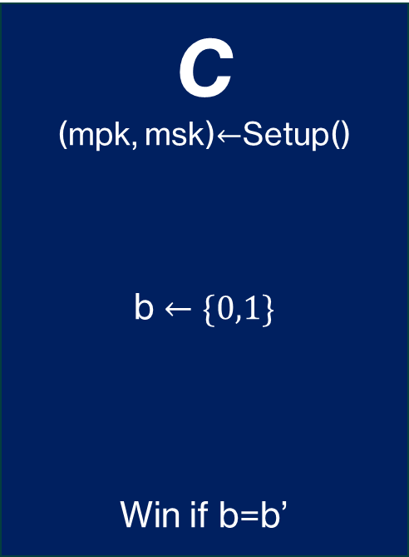
IBE Security
C
(mpk, msk)$←$Setup()
b $←\{0,1\}$
Win if b=b’
A
mpk
id
sk_{id}=KeyGen(msk, id)
id*, m₀, m₁
Enc(mpk, id*, m_{b})
b’
Secure if Pr[Win] is ½+negligible

Slide 21

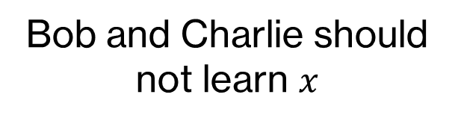



Functional Encryption (FE)
$$B(x)$$
Bob and Charlie should not learn $x$
$$x$$
$$C(x)$$

Slide 22

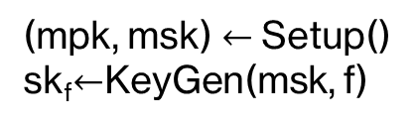
Functional Encryption (FE)
(Setup, KeyGen, Enc, Dec)
sk_{C}
$$x$$
Broadcast
sk_{B}
(mpk, msk) $←$Setup()
sk_{f}$←$KeyGen(msk, f)

Slide 23



Functional Encryption (FE)
(Setup, KeyGen, Enc, Dec)
C(x) $←$Dec(sk_{C}, ct)
$$x$$
sk_{C}
Broadcast
ct $←$Enc(mpk, x)
B(x) $←$Dec(sk_{B}, ct)
sk_{B}

Slide 24
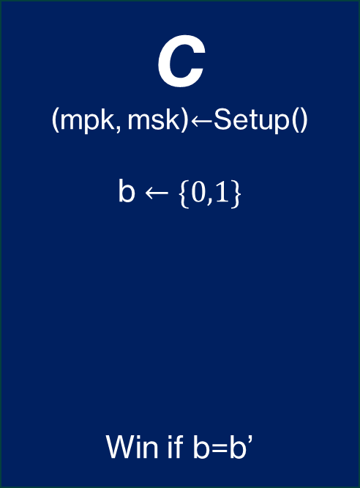
FE Security
C
(mpk, msk)$←$Setup()
b $←\{0,1\}$
Win if b=b’
A
f(x₀)=f(x₁)
mpk
x₀, x₁
ct=Enc(mpk, x_{b})
f
sk_{f}=KeyGen(msk, f)
b’
Secure if Pr[Win] is ½+negligible

Slide 25
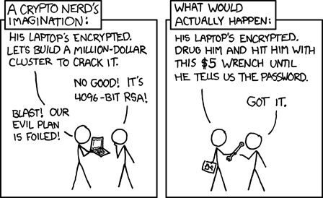
Thank you Any Questions?
Source: explain xkcd

